Slide 1
Giving and receiving

Slide 2
Promises given Luke 1v5-20
In the time of Herod king of Judea there was a priest named Zechariah, who belonged to the priestly division of Abijah; his wife Elizabeth was also a descendant of Aaron. ⁶ Both of them were righteous in the sight of God, observing all the Lord’s commands and decrees blamelessly. ⁷ But they were childless because Elizabeth was not able to conceive, and they were both very old.

Slide 3
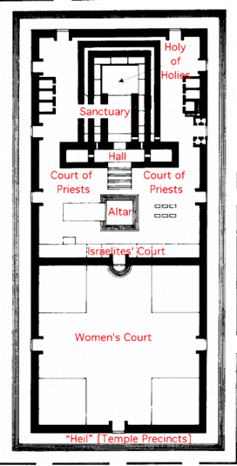
No Ordinary Day
⁸ Once when Zechariah’s division was on duty and he was serving as priest before God,⁹ he was chosen by lot, according to the custom of the priesthood, to go into the temple of the Lord and burn incense. ¹⁰ And when the time for the burning of incense came, all the assembled worshippers were praying outside.

Slide 4
No Ordinary Day
¹¹ Then an angel of the Lord appeared to him, standing at the right side of the altar of incense.¹² When Zechariah saw him, he was startled and was gripped with fear.¹³ But the angel said to him: ‘Do not be afraid, Zechariah; your prayer has been heard. Your wife Elizabeth will bear you a son, and you are to call him John. ¹⁴ He will be a joy and delight to you, and many will rejoice because of his birth,

Slide 5
No Ordinary Day
¹⁵ for he will be great in the sight of the Lord. He is never to take wine or other fermented drink, and he will be filled with the Holy Spirit even before he is born. ¹⁶ He will bring back many of the people of Israel to the Lord their God. ¹⁷ And he will go on before the Lord, in the spirit and power of Elijah, to turn the hearts of the parents to their children and the disobedient to the wisdom of the righteous – to make ready a people prepared for the Lord.’
Cross reference Malachi 4v5-6

Slide 6
A disappointing response
¹⁸ Zechariah asked the angel, ‘How can I be sure of this? I am an old man and my wife is well on in years.’
¹⁹ The angel said to him, ‘I am Gabriel. I stand in the presence of God, and I have been sent to speak to you and to tell you this good news.²⁰ And now you will be silent and not able to speak until the day this happens, because you did not believe my words, which will come true at their appointed time.’

Slide 7
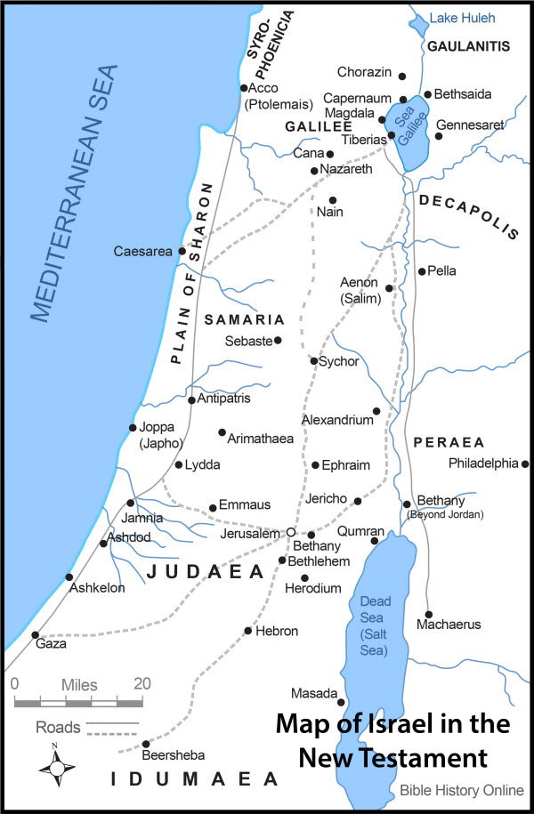
Another visit another place
²⁶ In the sixth month of Elizabeth’s pregnancy, God sent the angel Gabriel to Nazareth, a town in Galilee

Slide 8
Another visit, another promise
²⁶ In the sixth month of Elizabeth’s pregnancy, God sent the angel Gabriel to Nazareth, a town in Galilee, ²⁷ to a virgin pledged to be married to a man named Joseph, a descendant of David. The virgin’s name was Mary.²⁸ The angel went to her and said, ‘Greetings, you who are highly favoured! The Lord is with you.’
²⁹ Mary was greatly troubled at his words and wondered what kind of greeting this might be. ³⁰ But the angel said to her, ‘Do not be afraid, Mary, you have found favour with God.

Slide 9
Another visit, another promise
³¹ You will conceive and give birth to a son, and you are to call him Jesus. ³² He will be great and will be called the Son of the Most High. The Lord God will give him the throne of his father David,³³ and he will reign over Jacob’s descendants for ever; his kingdom will never end.’
Isaiah 9v7, 2 Sam 7v13

Slide 10
Another question, a different spirit
³⁴ ‘How will this be,’ Mary asked the angel, ‘since I am a virgin?’
³⁵ The angel answered, ‘The Holy Spirit will come on you, and the power of the Most High will overshadow you. So the holy one to be born will be called the Son of God. ³⁶ Even Elizabeth your relative is going to have a child in her old age, and she who was said to be unable to conceive is in her sixth month. ³⁷ For nothing is impossible with God.’
³⁸ ‘I am the Lord’s servant,’ Mary answered. ‘May your word to me be fulfilled.’ Then the angel left her.

Slide 11
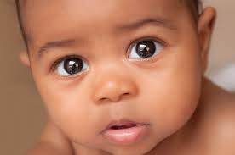
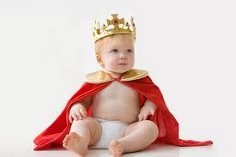
The forerunner and the King

Slide 12
The forerunner leaps
⁴¹ When Elizabeth heard Mary’s greeting, the baby leaped in her womb, and Elizabeth was filled with the Holy Spirit.⁴² In a loud voice she exclaimed: ‘Blessed are you among women, and blessed is the child you will bear! ⁴³ But why am I so favoured, that the mother of my Lord should come to me? ⁴⁴ As soon as the sound of your greeting reached my ears, the baby in my womb leaped for joy. ⁴⁵ Blessed is she who has believed that the Lord would fulfil his promises to her!’

Slide 13
Story so far…
Two visits
Two miraculous births promised
Masses of prophecies coming to fruition
2 responses of great faith, one less so

Slide 14
The virgin sings of a big God
⁴⁶ And Mary said:
‘My soul glorifies the Lord ⁴⁷ and my spirit rejoices in God my Saviour, ⁴⁸ for he has been mindful of the humble state of his servant. From now on all generations will call me blessed, ⁴⁹ for the Mighty One has done great things for me – holy is his name.

Slide 15
The virgin sings a big picture
⁵⁴ He has helped his servant Israel, remembering to be merciful ⁵⁵ to Abraham and his descendants for ever, just as he promised our ancestors.’
Helped/Succoured/Lifted up
Kept His promise
And the time is now
The Messiah/Christ will be born of me

Slide 16
Abraham blessed to be a blessing
Genesis 12v1-3
The Lord had said to Abram, ‘Go from your country, your people and your father’s household to the land I will show you. ² ‘I will make you into a great nation, and I will bless you; I will make your name great, and you will be a blessing. ³ I will bless those who bless you, and whoever curses you I will curse; and all peoples on earth will be blessed through you.’

Slide 17
Abraham blessed to be a blessing
Genesis 12v1-3
Genesis 22v18
“In your seed all the nations of the earth shall be blessed, because you have obeyed My voice.” NKJV
Genesis 22v8
And Abraham said, “My son, God will provide for Himself the lamb for a burnt offering.” So the two of them went together.
Cross ref John 1v29

Slide 18
Paul explains it
Galatian 3v16
“ The promises were spoken to Abraham and to his seed. Scripture does not say ‘and to seeds’, meaning many people, but ‘and to your seed’ meaning one person, who is Christ.

Slide 19
Paul expands it
Paul includes us in it (as intended)
Galatian 3v6-9
⁶ So also Abraham ‘believed God, and it was credited to him as righteousness.’
⁷ Understand, then, that those who have faith are children of Abraham.⁸ Scripture foresaw that God would justify the Gentiles by faith, and announced the gospel in advance to Abraham: ‘All nations will be blessed through you.’ ⁹ So those who rely on faith are blessed along with Abraham, the man of faith.
Cross reference John 856-58

Slide 20
A Promise keeping God
Mary tells us “He has helped His servant Israel” as promised to Abraham
Elizabeth responded personally
“My Lord”
Zechariah responded obediently Luke 1v62-63
⁶² Then they made signs to his father, to find out what he would like to name the child. ⁶³ He asked for a writing tablet, and to everyone’s astonishment he wrote, ‘His name is John.’

Slide 21
A Promise keeping God
Mary tells us “He has helped His servant Israel” as promised to Abraham
Elizabeth responded personally
“My Lord”
Zechariah responded obediently Luke 1v62-63
Jesus is still Immanuel
For He Himself has said, “I will never leave you nor forsake you.”

